Slide 1
DECK 1 – Introduction to digitization and analytics
Dr. Jack Hong
Adjunct Faculty, Lee Kong Chian School of Business, SMU
Co-founder, Research Room Pte. Ltd.

Slide 2
Lesson plan

Slide 3
Lesson Plan
The materials in this pre-course are designed to equip you with:
A high level understanding of the principles and application of data analytics
Basic technical skills in implementing data analytics projects
Python and R

Slide 4
Lesson plan
Deck 1 – Introduction
Demystifying digitization
Demystifying analytics
Analytics use-cases
Data science framework
Computing basics
Deck 2 – Coding
Introduction to coding
Introduction to Python and R
Deck 3 – Basic Statistical Models
Linear and Logistic Regression
Deck 4 – Basic Machine Learning Models

Slide 5
Demystifying digitization

Slide 6
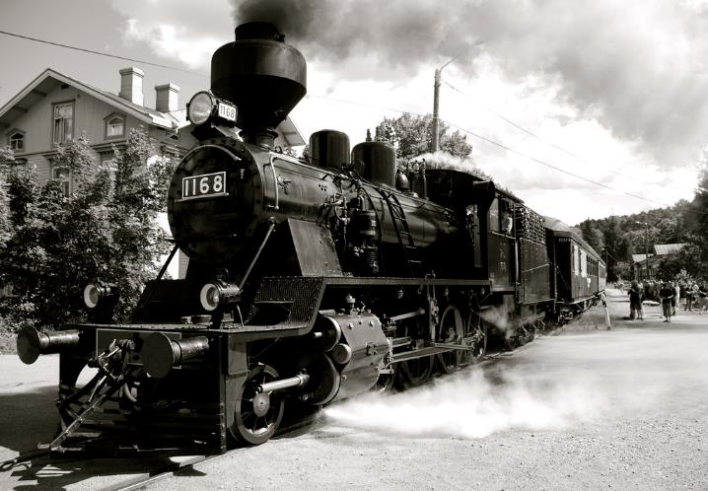
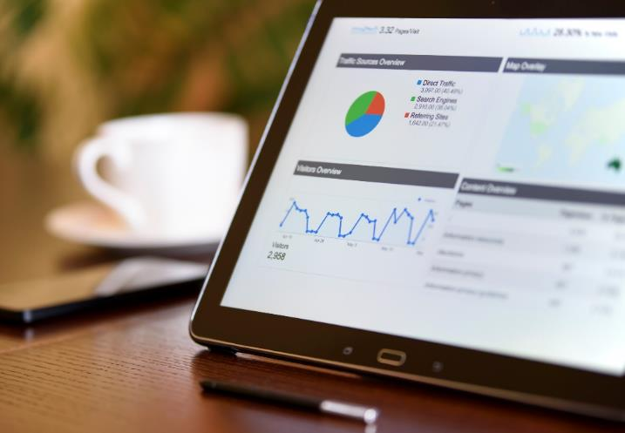
The age of digitization
The age of industrialization created technology and machines that scale our physical abilities
The age of digitization created technology and machines that scale our mental and decision making abilities

Slide 7
Why does the business world need to care about Digitization?
Disrupt or be disrupted
Replicative (Provide more of existing goods and services: Cheaper, better, faster)
Innovative (Reshape industries and add value to the economy)
Google, Facebook, Wechat, Alibaba and Taobao
Cater to changing consumer expectations or lose your customers
Instant gratification
News, anytime, anywhere
One click setup
24/7 immediate response
Automated administrative tasks – e.g. approvals, transfers, form filling
Personalized treatment with seamless transition across multiple business or lifestyle touchpoints
Community wisdom and reputation building

Slide 8
Why do we care about Digitization?
Increase productivity
Reduce processes and increase accuracy (e.g. smart document identification, automated rules)
Identify anomalies accurately and instantaneously (e.g. fraudulent/erroneous entries)
Augment human decision-making with smart analytics to increase speed and accuracy (e.g. sentiment and topic identification for feedback)
Increase job satisfaction
Reduce mundane tasks, increase engaging ones
Cultivate and deepen skillsets of the future

Slide 9
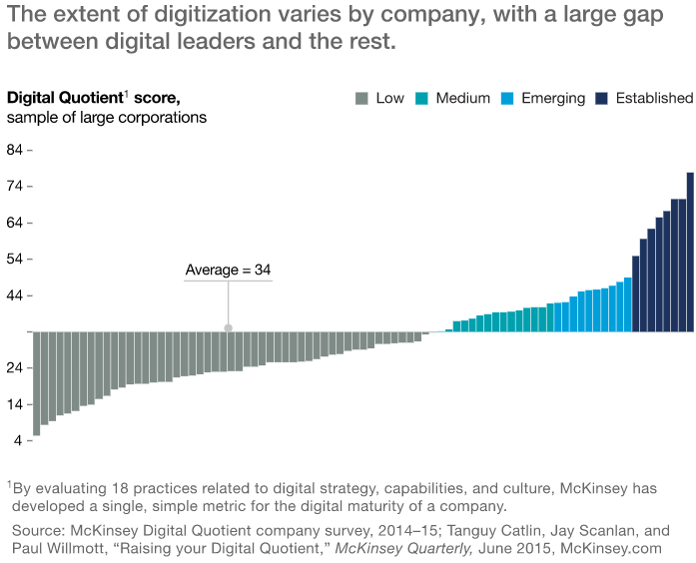
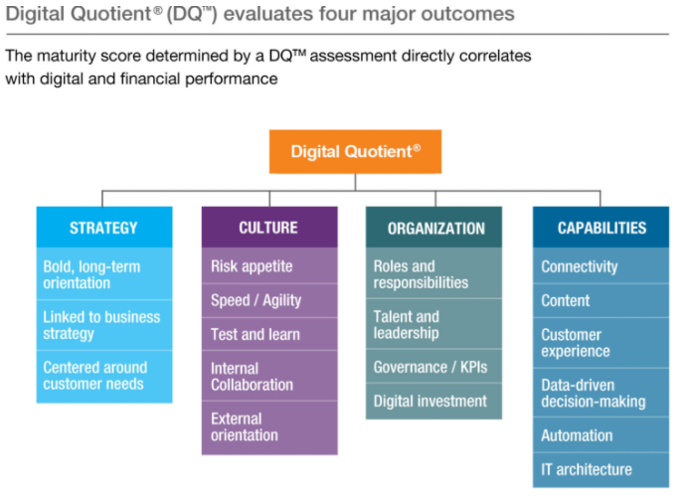
The current state of digitization
Source: McKinsey Global Institute “What’s now and next in analytics, AI, and automation.” May 2017

Slide 10

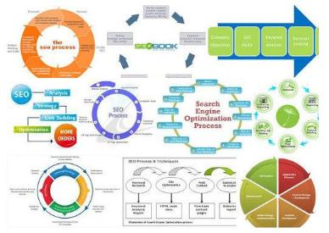

Digitization involves more than just tech and developers
New infrastructure and assets in technology
Computing resources (machines, network etc.)
Data and the software to analyze them effectively
Re-engineer business management to new technology stack
Workflow and processes
Operating, financing, investing activities
Upstream (supply chain) to downstream (customers) processes
Invest in human capital to wield new technology
Enlightened management in technology
Key appointment holders that can bridge technology with business
Clearly defined digital roles and responsibilities

Slide 11


A real life example (Product)
Digitization involves hardware, software, business process re-design and most importantly, human capital
Real-time multi-channel monitoring and feedback
Real-time team communications Agile management methodologies
Real-time inventory monitoring and prediction modules
Enterprise Resource System to allow seamless ordering, replenishment, replacement, billing, and qualitative feedback
Enhance production
processes with factories
Sourcing
Logistics
Production
Product R&D
Collect large amounts of information
Scientific methods to extract insights in an unbiased manner
Fast fulfilment
Re-iterate and improve
Businesses
Distribution Hub
Surveys, interviews, focus groups, feedback
Extract:
1. Unique Selling Points
2. Consumer preferences
3. Other strategic marketing considerations
Targeted ordering
Retail customers
Stores
Engagement
Design campaigns
Strategic marketing and branding
Available for digitization
Precision marketing through distributed information channels
Real-time sensing (and response) with automated sentiment and topic analysis

Slide 12
Demystifying Analytics
the foundation of Artificial intelligence

Slide 13
Computers vs humans
The common saying is that computers are way behind humans in higher cognitive skills, such as
Relationship mapping
Synthesizing different ideas
Extracting contexts

Slide 14
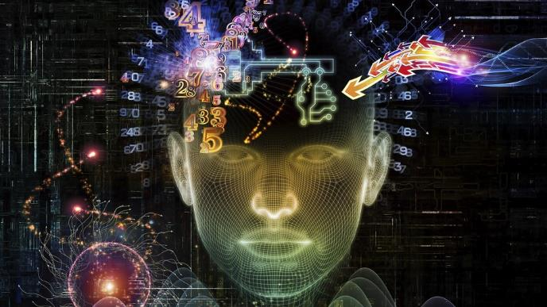
Really?
Context-based AI
Siri and Google Assistant
Bested the best experts in tasks that are considered to be too complex even for most humans
Defeated 7 times world champion in Jeopardy! (a game where contestants guess the question from 3 related answers)
IBM’s Deep Blue defeated Garry Kasparov in 1997
Google’s AlphaGo bested the best grandmasters in recent years in the game of Go
Google’s AlphaGo Zero then beat AlphaGo by 100 games to 0

Slide 15
We need to be equipped for a future built by data
The core value-add of these artificial intelligence (AI) applications lies in the ability to make sense of what has happened, is happening, and predict what will happen
The tools in which this core value-add is built upon
Insane amounts of data
A huge variety of data types (from quantitative to qualitative)
Statistics, machine learning, and other mathematical methods
Computing resources and skillsets are critical because they are the only avenues for us to unlock the value of AI
The future of data science is not tailored for only computer science specialists
Domain experts who can teach machines what and how to learn
Innovative people who knows how to use machines and AI to push the boundaries of the fields that they are in (including business)
Analytics algorithms have been commoditized to the extent that anyone can use them without substantial mathematical or coding training
Analytics algorithms are general functions that are implemented in the same way across all analytics software (learn one, learn all)

Slide 16
What is analytics?
Relating to domain expertise
Asking the right questions (formulate hypotheses)
Extracting the right answers (interpreting results from analytical models)
Relating to analytical techniques
Using machine learning and deep learning to extract patterns from data (without defining rules)
Using statistics to represent and describe the data
Applying decision rules to data
Aggregating and segmenting data (dice and slice)
Relating to data technology
Translating business data into machine readable formats
Managing and linking data sources
Allowing large amounts of data to be stored and retrieved quickly
Increasing Complexity/ Intelligence
Analytics help us discover new insights from data,
through rigorous scientific interpretations of the patterns in them
Notes:
Analytics is both an art and a science

Slide 17

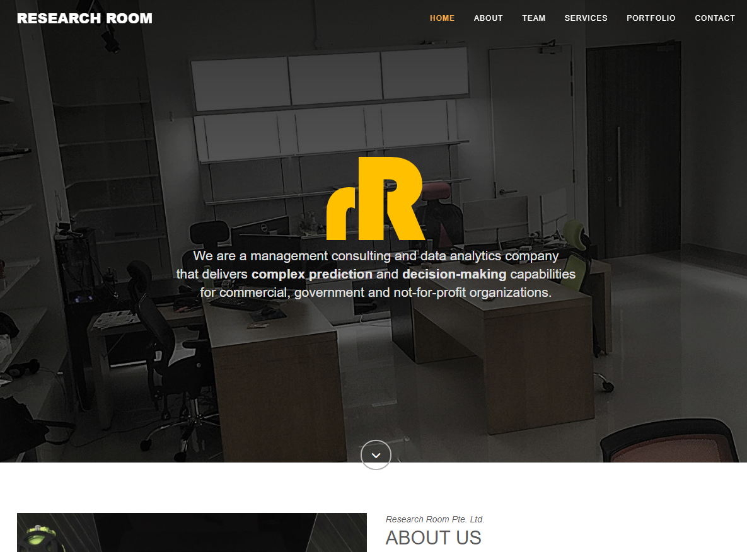
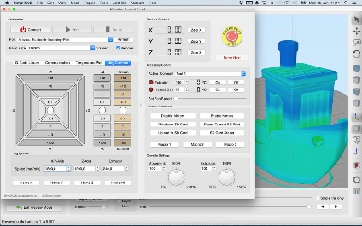

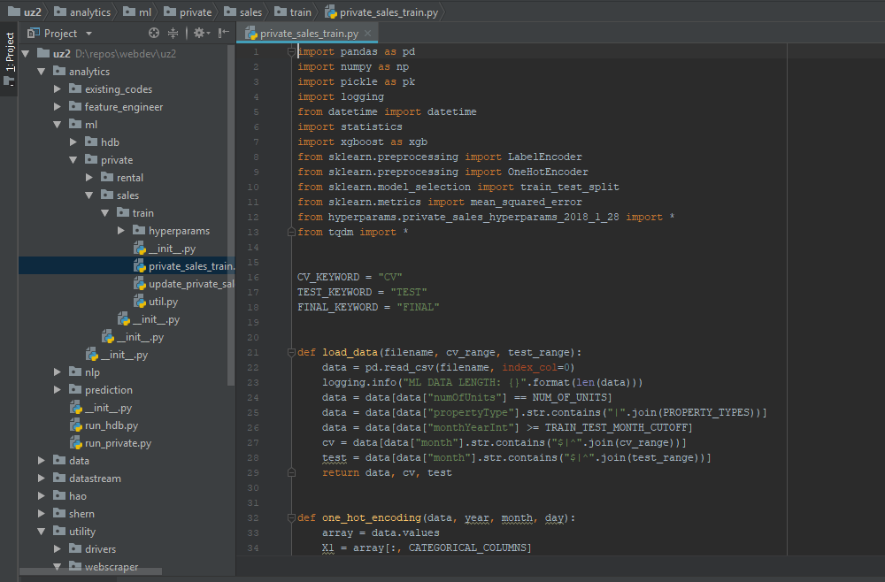
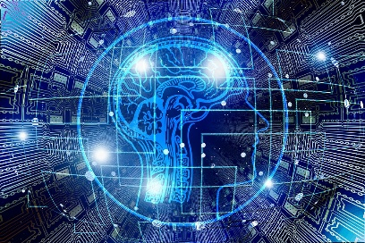

Where do we place analytics in the digitization value chain?
Frontend
Focused on the development of user interfaces (with good User Experience)
Apps UI/UX
Web UI/UX
System UI
(typically internal facing)
UI: User Interface; UX: User Experience
User Inputs
Results Output
Backend
Focused on the development of the digital architecture and functionalities
Architecture codes
- Glues all digital components together
Functionality codes
- Supports the functionalities of the digital solution
Analytics codes
- Creates intelligent responses based on data inputs from any components in the digital solution
Database
Where all data are stored and persisted

Slide 18

In god we trust, all others bring data
- W. Edwards Deming

Slide 19




analytics algorithms: what do they do?
Analytics algorithms uses mathematics to extract complex patterns from data
These mathematical techniques are generally classified into:
Supervised learning: Humans show the machine which output relates to which inputs, and the machines will learn the associations without additional human intervention
Unsupervised learning: Identifies patterns in the data without any human intervention
Supervised Learning
Is this A or B?
Classification
1 2 3
How many?
Regression
A / B
Unsupervised Learning
How is it organized?
Clustering / Segmentation
What matters?
Dimension Reduction / Addition
Others
Is this weird?
Anomaly Detection
What should I do next?
Recommendation

Slide 20

Analytics and must be guided by business objectives - where are you pointing your weapon at?
As a simple analogy
analytics algorithms tell you the best way to reach point A from point B
however, you need to determine what points A and B are
Analytics is powerful when you have clear business objectives/outcomes
Generally, analytics have shown great success in enhancing the following business objectives
Net Value
↓ cost / ↑ revenue
Satisfaction
Mundane
$
Productivity
More with less, faster

Slide 21
Analytics use-cases

Slide 22

Netflix Recommendation
recommendation
Answering:
Business Objective:
Netflix has classified 76,897 micro-genres for their collection of shows and movies
Using browsing behaviors, Netflix is able to associate viewer characteristics with what they (or similar users) watched
A popular analytics algorithm that is used to for similar recommendation systems is the Matrix Factorization
This probabilistic model is used to infer what new viewers may like to watch
segmentation
satisfaction
Notes:
Genres formula: Region + Adjectives + Noun Genre + Based On . . . + Set In . . . + From the . . . + About . . . + For Age X to Y

Slide 23



Community Engagement
recommendation
Answering:
Business Objective:
This project utilizes the same recommendation algorithms on activities curation
Depending on user profile and preferences, with environment variables (location, time of day, weather etc.)
The analytics algorithm can recommend immediate activities that the user may like to pursue
segmentation
satisfaction
Notes:
Inference (activities are curated based on themes and novelty)
- An example of man and machine synergy

Slide 24
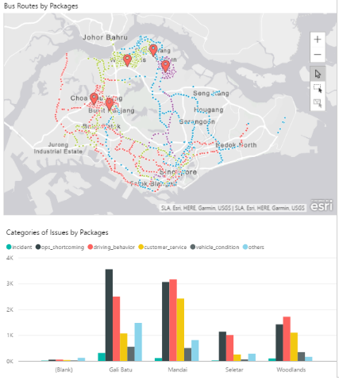
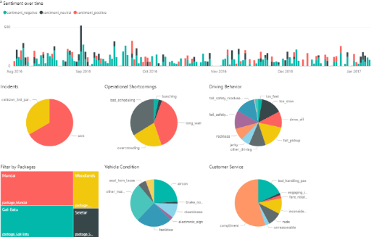
Social Media Analytics
Answering:
Business Objective:
By associating words used in social media with sentiments and entities (e.g. air-conditioning, doors, seats)
The analytics algorithm is able to pick up negative posts, and extract important contexts within the post
Sentiment: complaint or compliment?
What is it about? (e.g. moving too slowly, air con too warm)
Using analytics allow us to
Fully automate this customer service process
Provide consistent & high quality classification outcomes
A / B
classification
productivity
Notes:
Speed, automation, consistent and high quality classification outcomes, powerful visualizations to for quick decision-making

Slide 25
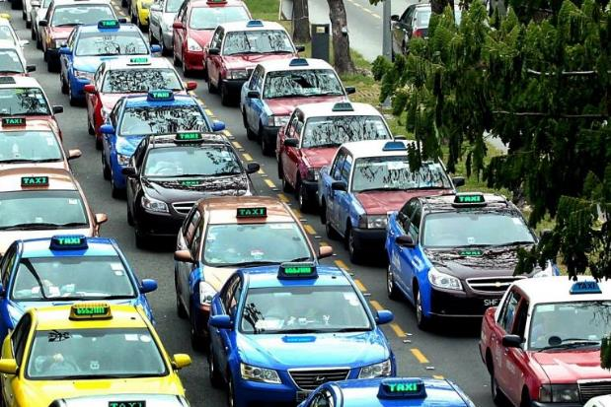

Predictive Taxi Dispatching
how many?
Answering:
Business Objective:
Machine learning algorithms was used to associate past taxi waiting times at Changi Airport Taxi Holding Area with environment variables such as
Weather
Time / Day (Holidays/Seasonal)
Flight load (no., origin)
This model was then used to predict taxi waiting times
The basic model is accurate within 78.8 seconds, 95% of the time
Unsupervised algorithms also revealed a network of taxi drivers who can consistently achieve very little waiting time
The existence of taxi driver cliques with a common communication network
1 2 3
productivity
Notes:
From reactive to proactive dispatching
Jan longest waiting, Monday shortest
Increase rain, decrease waiting time
Increase temperature, decrease waiting time
High winds increase waiting time
Short holidays increase, long school holidays decrease, short sch holidays no effect
More queue, less time

Slide 26

Target Corp Market Basket Analytics
classification
A / B
Answering:
Business Objective:
This is a famous example of the market basket algorithm in machine learning
Target used the algorithm on transaction level data and computed the probabilities of 2 or more items appearing in the same customer checkout cart
If the actual probability of 2 items appearing in the same cart is higher than the joint probability, then this pair of products is considered novel
Target then places novel products in close proximity within their stores to drive sales
Beer & Diapers
Scent-free soap, extra-big bags of cotton balls
segmentation
$
net value

Slide 27
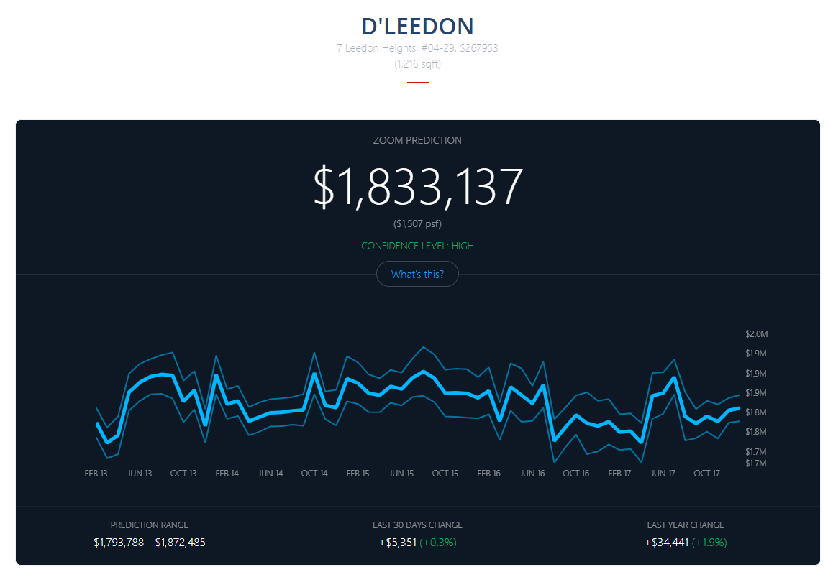
Urban zoom – home auto valuation
Answering:
Business Objective:
Using advanced machine learning models on a massive data set that has every unit-level transaction in Singapore since 1980
associate home prices with a huge database of home, location, and time characteristics
Able to facilitate instant valuation for all homes in Singapore
The model is able to achieve median error in predicted value of 2.4%
classification
A / B
segmentation
satisfaction

Slide 28
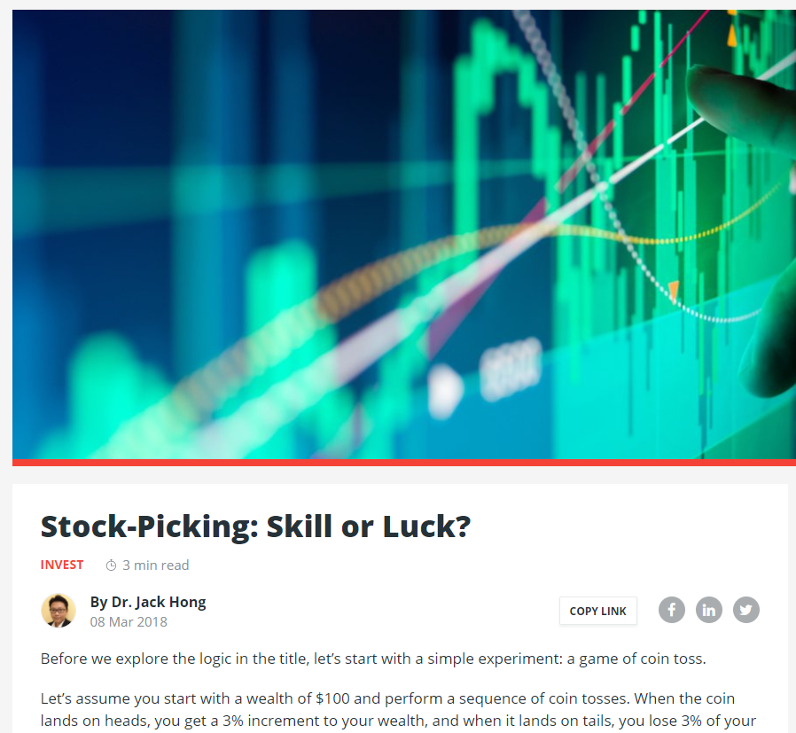
Customized education journey
classification
Answering:
Business Objective:
Education content is mapped to a knowledge map based on a financial curriculum
Advanced machine learning algorithms predict the optimal learning journey and recommend new content based on user interests (as revealed by their choice of content)
A / B
segmentation
satisfaction

Slide 29
Data Science Framework
From ideas to deliverables

Slide 30
The data science value chain
The process to bring analytics ideas to life can be generalized into an empirical framework
This framework is modeled after the scientific approach that empirical researchers use to develop insights.
We will use this framework as a guide in this course
Data Collection
Data Exploration
Prediction/ Prescription modeling
Data Munging
Identify data sources
Collect data (APIs, crawlers, human labor etc.)
Identify and implement the best data structures for storage and retrieval
Identify and access datasets
Append/merge datasets into views
Clean, transform and replace data
Descriptive statistics and preliminary data investigation
Apply multiple statistical and machine learning models
Model selection
Model comparison
Analyze useful features
Does it fit the research questions?
Predict the future using the best model
Consider budget and other constraints

Slide 31
Heavily reliant on computing power
Each element in the data science value chain is heavily reliant on computing power
Step 1: Data collection
Many information sources are in data format (e.g. excel, csv)
Increasingly, data are being provided in API format (e.g. data.gov.sg) which requires coding for retrieval purposes
Some data sources are so massive that we could only pull in batches or on demand
Step 2: Data munging
Many data sources are not represented in a form that fits our purposes
Many data sources are also “dirty”, such as data entry errors, missing data, wrong formatting
Due to the sheer size of the data that we need to work with, manual cleaning takes too much time
As such, we rely on codes and algorithms to clean the data
Step 3 and 4: Data exploration, prediction, and prescription
Computing by hand is not an option

Slide 32
Computing basics
What is a computer do?

Slide 33
Computing basics (hardware)
What does a computer do?
A computer computes!
Using the biological brain as an analogy
Central Processing Unit (CPU)
=
Frontal Lobe (calculates)
Random Access Memory (RAM)
=
Working (fast) memory
Disk Drives
=
Long term (slow) memory
GPU (graphical processing unit) is similar to CPU and is extensively used in deep learning models
1 video card packs hundreds to thousands of processing units, compared to 2 or 4 processing units in a laptop/personal computer
Accessing data from RAM is much faster than accessing data from disks
However, all data in RAM is flushed out when the machine is turned off
Also, RAM is much more expensive than disks
This is the cheapest form of data storage
Data persists in these disks until you scrub them

Slide 34
Computers vs humans
Computers beat brains in terms of
Speed (computation and recall)
How long do you think it will take my MacBook Pro to compute (369123 * 369123) and repeat it 100 million (100,000,000) times?
Answer: Less than 4 seconds
Accuracy (perfect recall)
Will a computer system return different data the same way you call it every time?
Working volume
How many wikipedia (the entire site with all its data) can a S$100 hard disk hold?
Answer: About 10

Slide 35

Architecture
What happens when you execute a piece of code?
CPU computes according to programming logic
Operators: + - / x
Logic: if/then/else
Flow: while x < 1
Where does it store and read data and steps?
Random Access Memory (RAM)
Requires unique physical locations on the hardware (memory addresses)
Since RAM is like a storage, can we use disk drives in place of RAM?
Yes, OS X and Windows are doing that (virtual memory/pagefile/swap)
But they only use it for very specific situations, why?
RAM is 33x faster than SSD, which is 100x faster than HDD
Disk drives have limited writes (SSD will wear out in 2 months)
CPUs can only pre-load data into its cache (small temporary storage area) from RAM

Slide 36
Questions?
Email any queries to
jackhong@smu.edu.sg

